Slide 1
Teacher Notes
I typically finish my geometry unit right before Christmas break, and I wanted to give my students a fun geometry culminating project. I also needed a project that did not include area and perimeter. While the concept would tie in perfectly with the project, I haven’t introduced those topics yet, and I don’t want my students confused. This lead to my new Christmas Geometry Project!
There are three parts to this activity, and I would suggest allotting about three-five days for students to complete the task.
Part 1-In Part 1, students receive a letter from Santa Claus that asks for their help creating a drawing of Christmas Village. Students must prove that they are able to draw a variety of geometric figures before proceeding to Part 2. Students will use grid paper to draw the shapes, so that they can ensure equal side lengths.
Part 2- In this portion, students will use graph paper to create a rough draft of the Christmas Village. Students will receive a directions page and two pieces of graph paper (I’ve found that one isn’t enough). You will want to have students tape the two pieces of grid paper together on the back, so it looks like one large sheet of paper (pictures included). Students should use a pencil to draw Christmas Village on the grid paper. Once students are happy with their plan, they should outline and label each building.
Part 3-This is where students can show off their creativity! Students should draw Christmas Village on a large scale. They may draw their picture on 12x18 construction paper, poster board, or chart paper. If you have access, chart paper with grid lines is perfect, because it helps students keep their shapes neat.
Ashleigh’s Education Journey

Slide 2
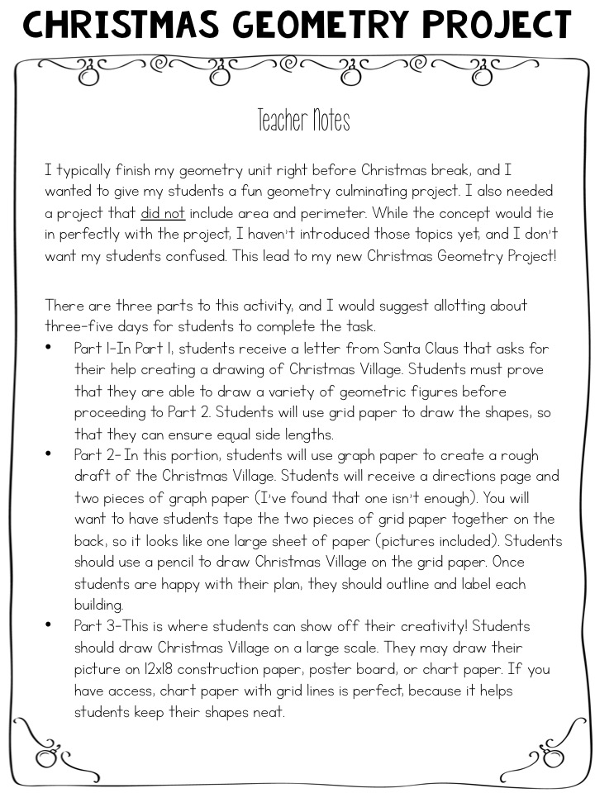
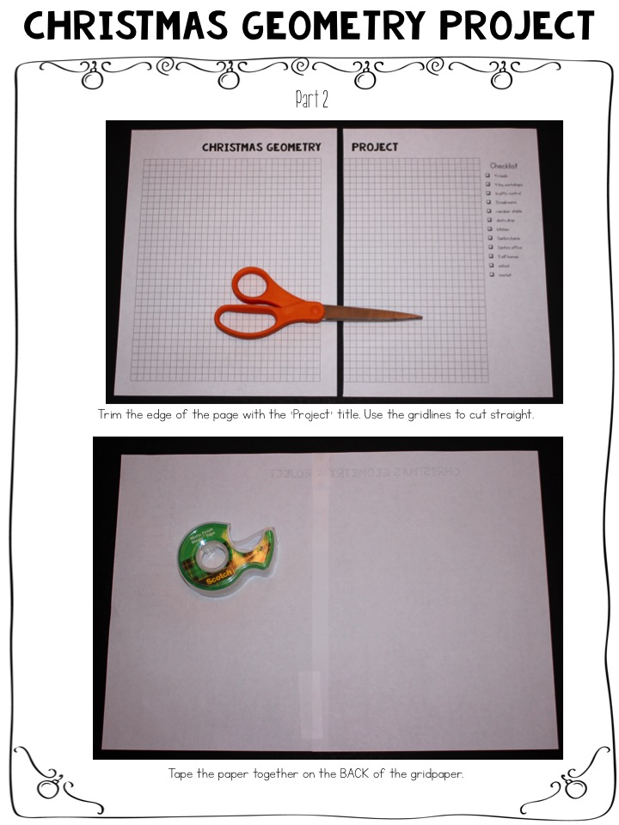
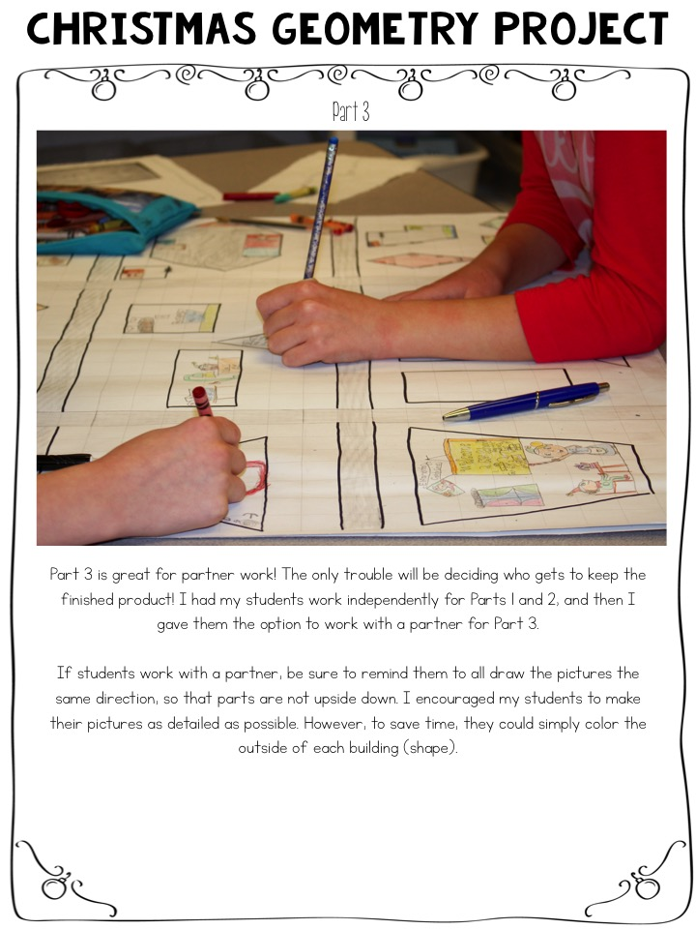
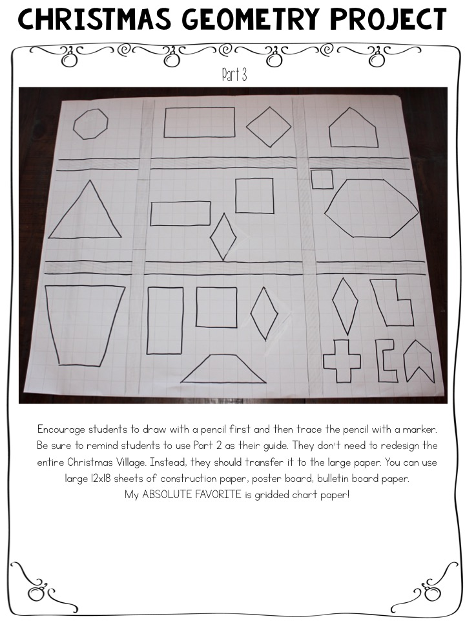
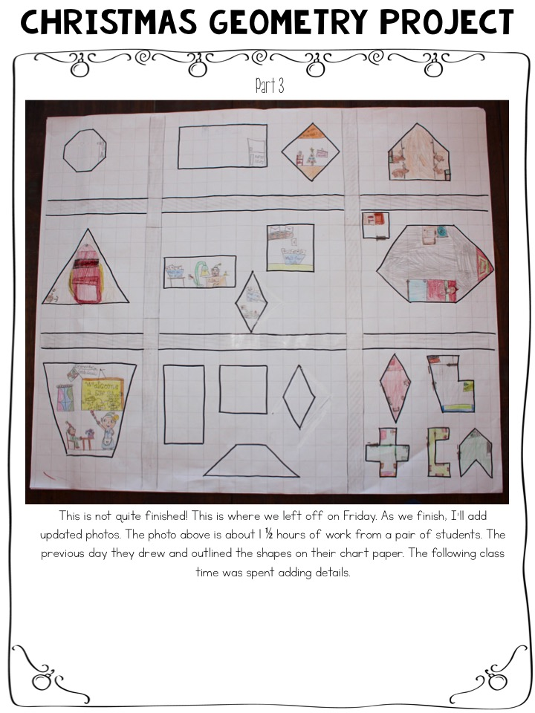
Teacher directions

Slide 3
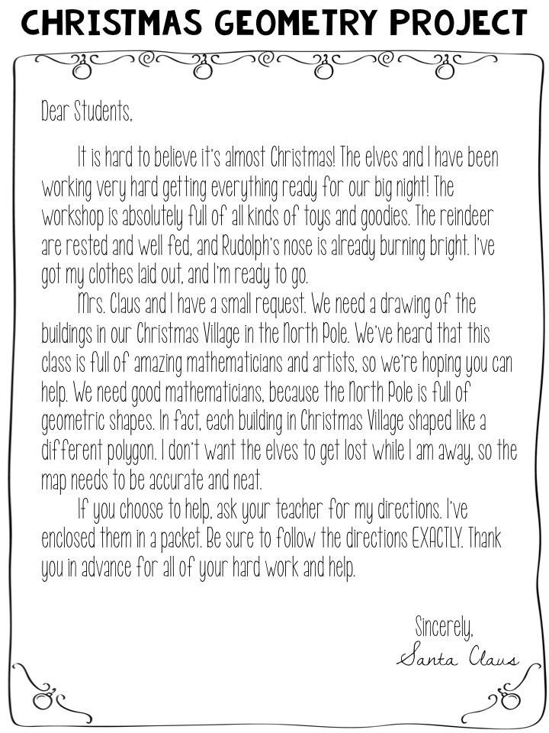
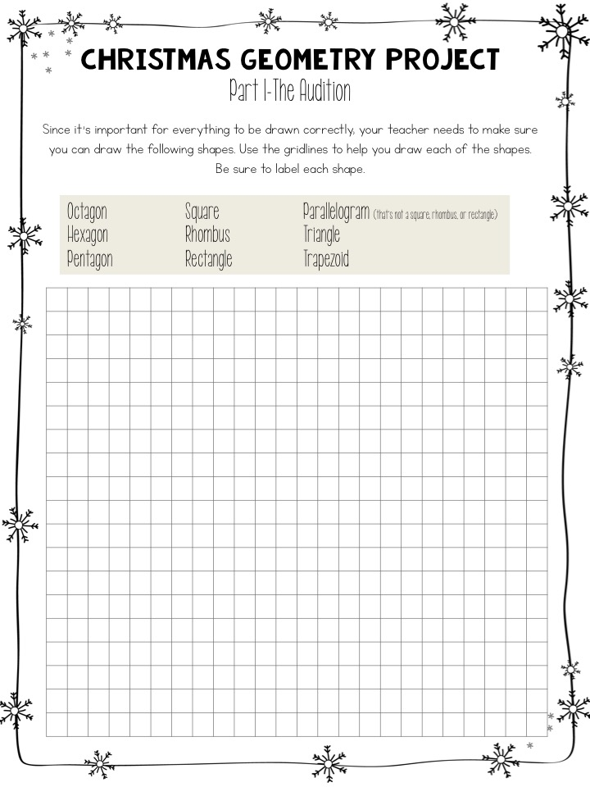
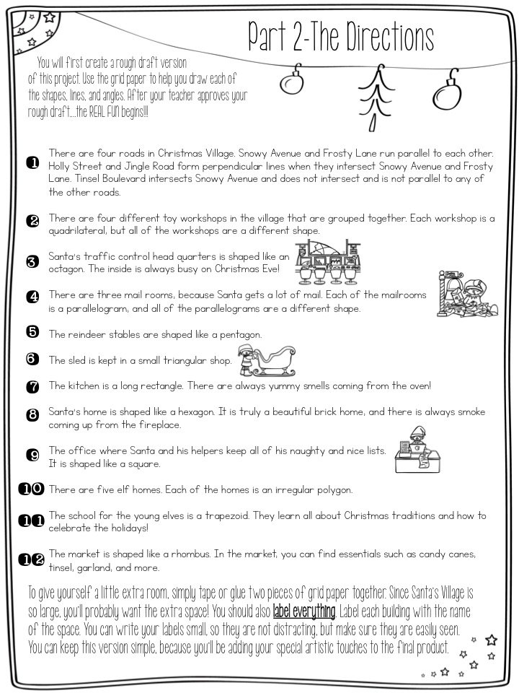
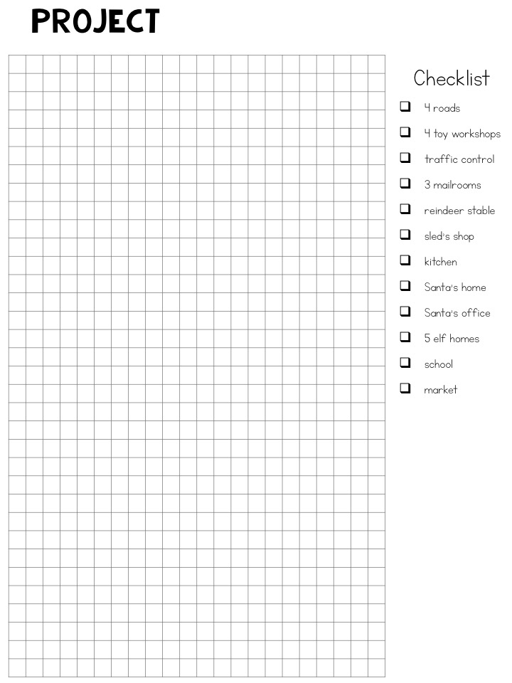
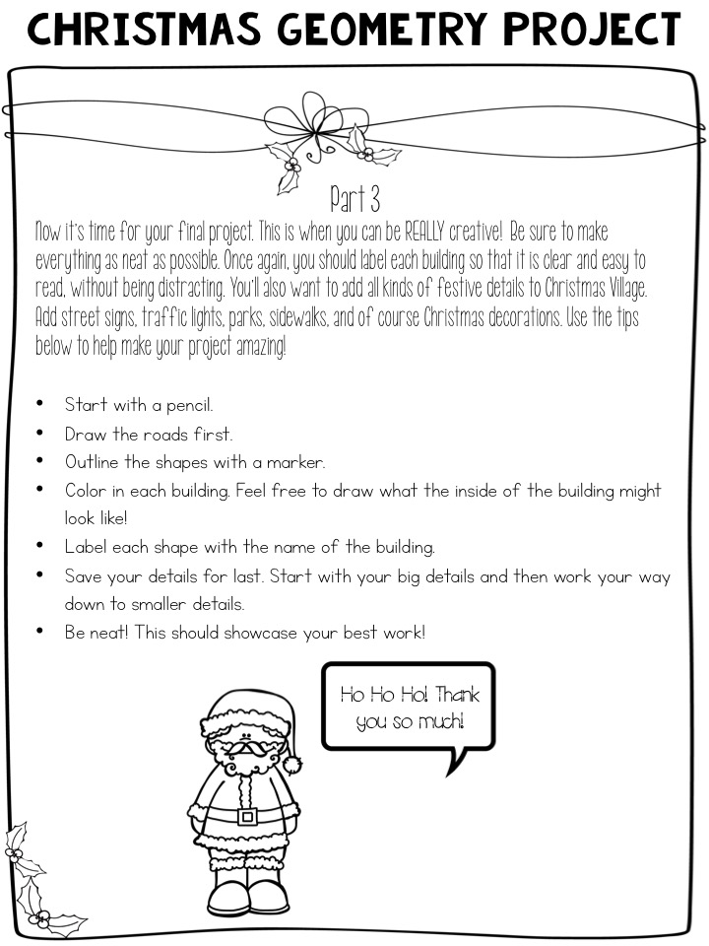
student Pages

